Slide 1
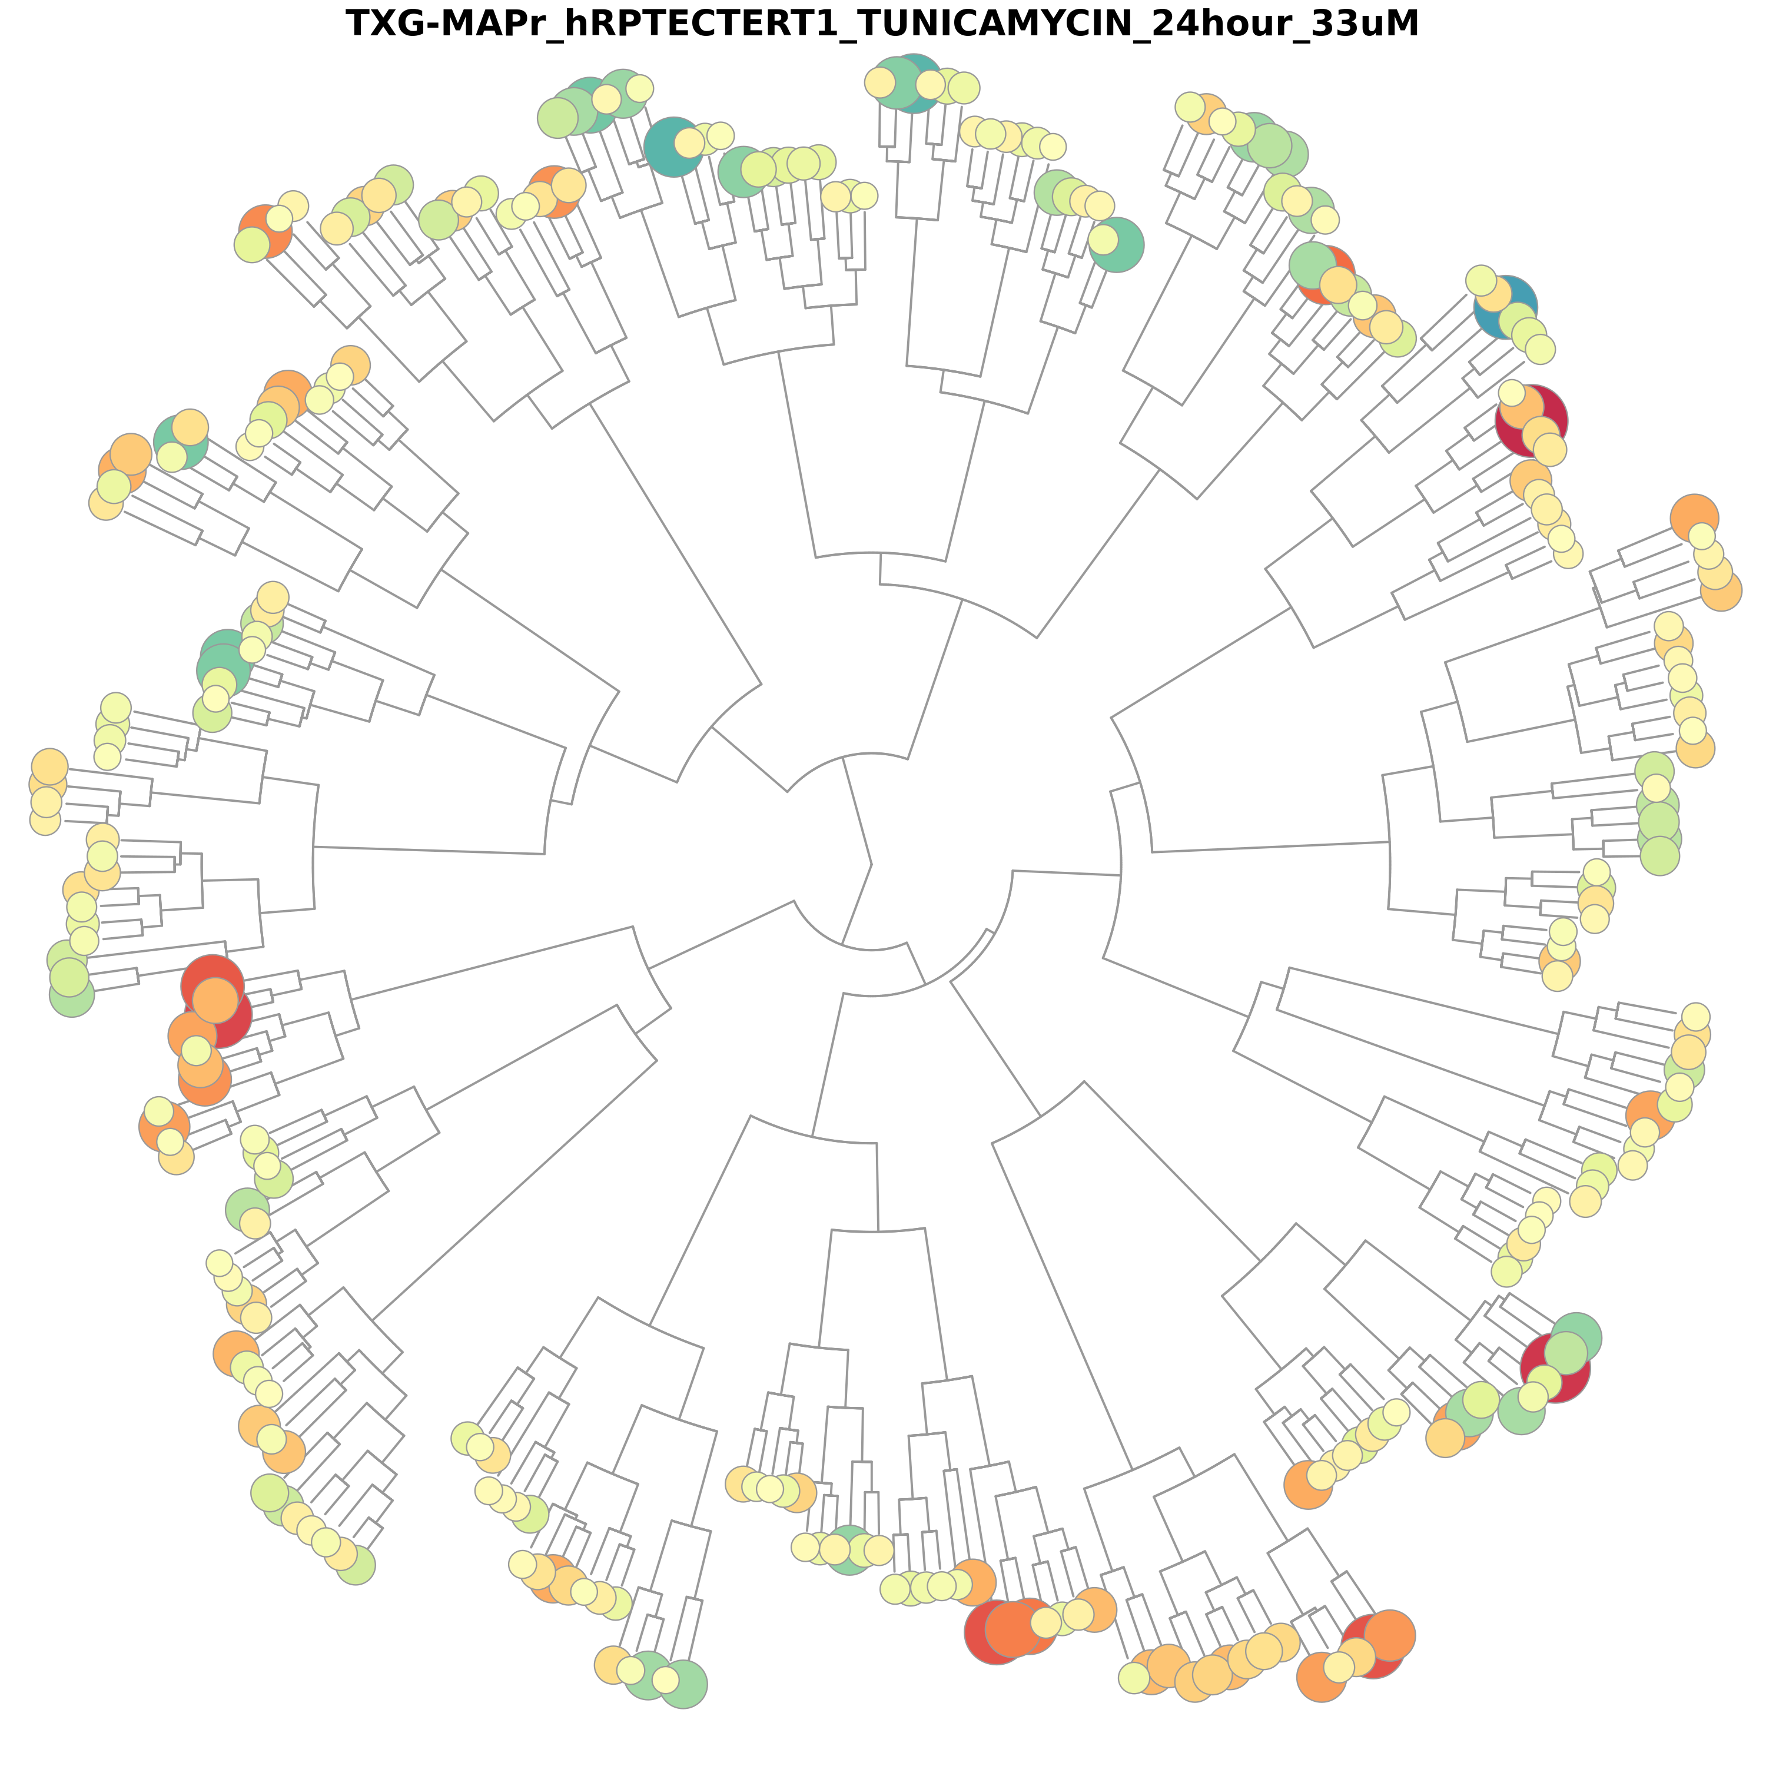

Network analysis of toxicogenomics data
Giulia Callegaro & Imke Bruns, Leiden University (LACDR)

Slide 2
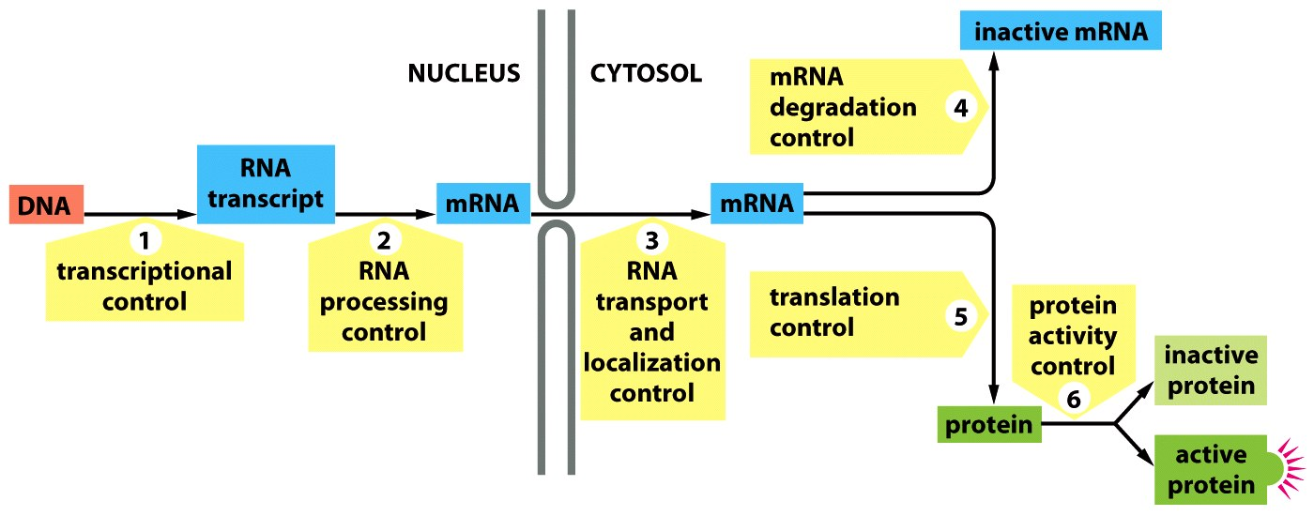
Toxicogenomics data
Figure 8-3 Essential Cell Biology (© Garland Science 2010)

Slide 3
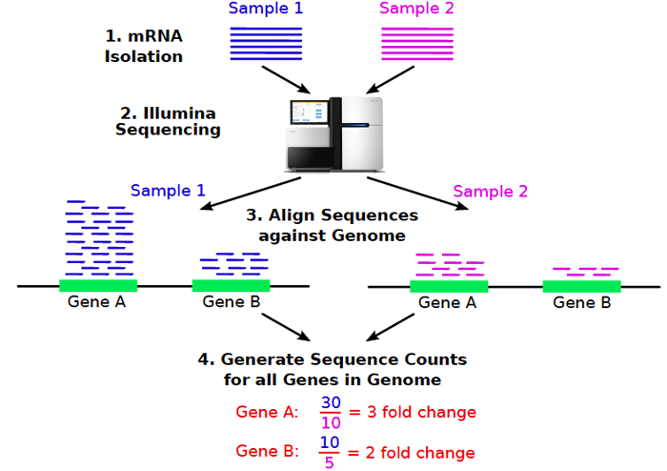
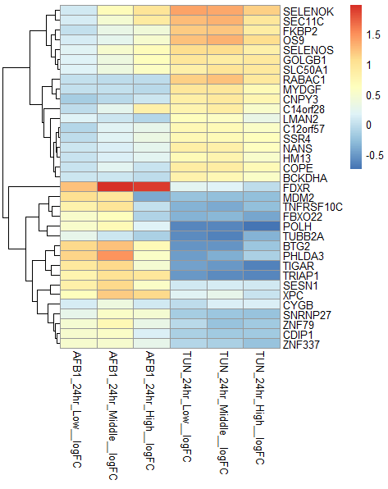
Toxicogenomics data analysis
R-ODAF pipeline
https://doi.org/10.1016/j.yrtph.2022.105143
Transcriptomic data processing
Not covered by this training
QC, filtering of poor samples and probes, gene mapping, normalization, transformation, differential gene expression analysis
-log10 P-value
log2 FC
https://faculty.ucr.edu/~tgirke/HTML_Presentations/Manuals/Workshop_Dec_12_16_2013/Rrnaseq/Rrnaseq.pdf

Slide 4
Toxicogenomics data analysis
R-ODAF pipeline
https://doi.org/10.1016/j.yrtph.2022.105143
Transcriptomic data processing
Not covered by this training
QC, filtering of poor samples and probes, gene mapping, normalization, transformation, differential gene expression analysis
e.g. GSEA, IPA, ORA etc etc https://doi.org/10.3389/fgene.2020.00654
e.g. BMDExpress https://www.epa.gov/system/files/documents/2023-08/05_Auerbach_EPA%20BOSC%20presentation-final.pdf
Interpret with current knowledge
Data-driven interpretation
Relate to dose/concentration
Not covered by this training
Not covered by this training
Identification of perturbed pathways: gene set analysis
Network analysis and WGCNA
Are genes/pathways showing dose-dependent transitions?

Slide 5
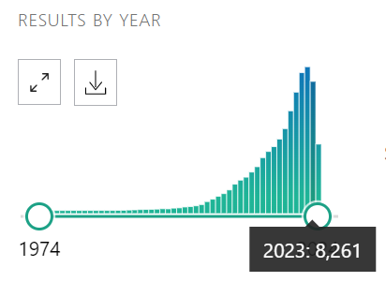
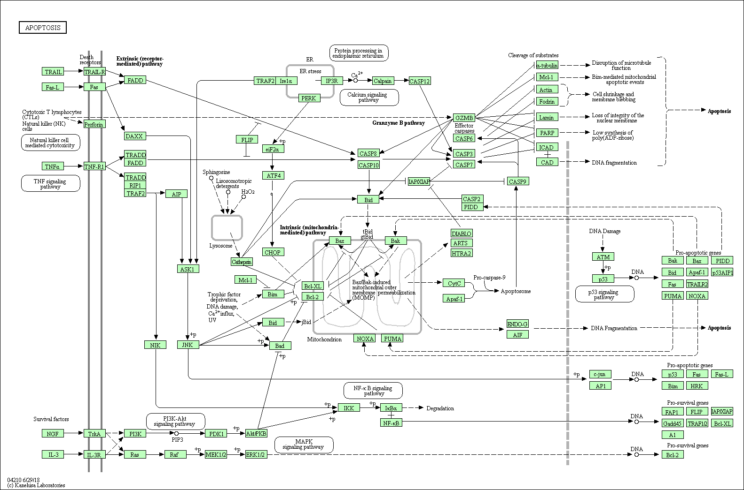
Gene network analysis
What shall we do with all those (differentially) expressed genes?
Looking at them one by one enough?
A
A
C
B
C
B
D
D
E
E
outcome
outcome

Slide 6
Gene (regulatory) networks
A
C
B
Complicated functional pathways in a given cell or tissue, which represent living processes such as metabolism, gene regulation, transport mechanisms or signal transduction
Key components:
Input
Network construction: using statistical and computational methods to determine the relationships between genes.
D
E
outcome
Information theory models or co-expression networks
Boolean networks
Differential equations models
Bayesian networks
Neural networks
https://doi.org/10.1016/j.artmed.2018.10.006

Slide 7
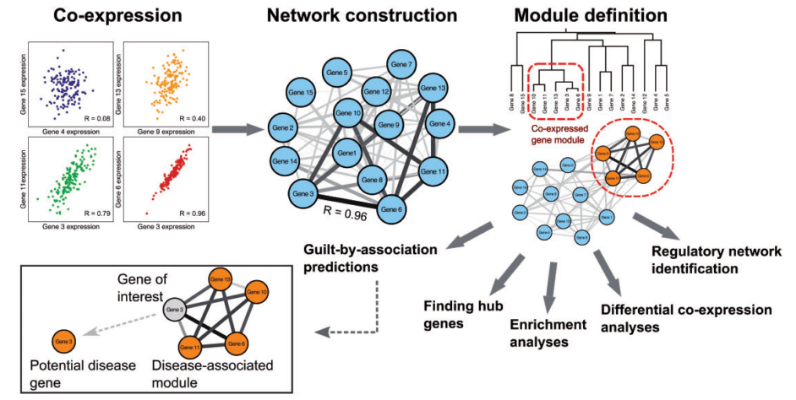
Gene co-expression networks
Group genes with a tendency to co-activate across a group of samples
How to measure the tendency of pairs of genes to co-activate?
van Dam, S., Võsa, U., van der Graaf, A., Franke, L., & de Magalhães, J. P. (2017)

Slide 8
Gene co-expression networks
Group genes with a tendency to co-activate across a group of samples
Co-expression == Pairwise gene correlation across all the conditions
van Dam, S., Võsa, U., van der Graaf, A., Franke, L., & de Magalhães, J. P. (2017)
Notes:
Describe what every dot is
Carry on examples of genes

Slide 9
Gene co-expression networks
Group genes with a tendency to co-activate across a group of samples
Isolate the gene clusters, called modules.
A module is a group of genes that tend to be co-expressed
van Dam, S., Võsa, U., van der Graaf, A., Franke, L., & de Magalhães, J. P. (2017)

Slide 10
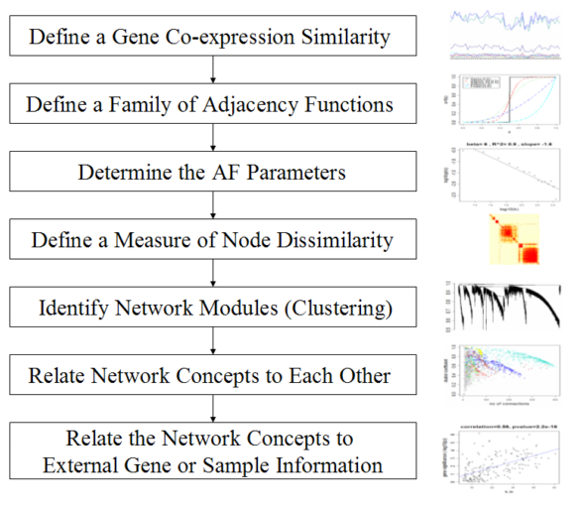
Weighted gene co-expression network (WGCNA)
The details of the algorithm:
1
characterize gene pairwise co-expression
2
3
4
Define the gene modules: groups of genes whose expression profiles are highly correlated across the samples
5
E.g. score modules based on eigengene values
6
E.g. define GO categories enriched in each module
7
Zhang, B., & Horvath, S. (2005).

Slide 11
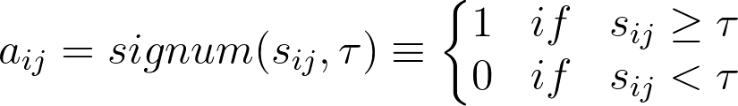

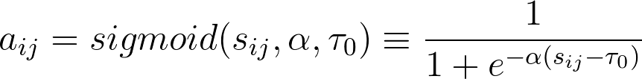
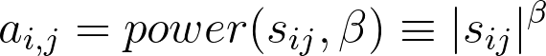
Weighted gene co-expression network (WGCNA)
Characterize gene pairwise co-expression
The gene correlation network is created using the Pearson correlation as a co-expression measure of a given gene across perturbations.
The challenge:
Threshold the Pearson correlation coefficient to arrive at a “relevant” network. Nodes should be connected only if they have a significant pairwise expression profile association.
1
1
2
2
3
4
1
Define Gene Co-expression similarity
Define a family of Adjacency Functions
2
Define a measure of similarity between the gene expression profiles to obtain a similarity matrix S
The adjacency function is a monotonically increasing function that maps [0,1] into [0,1]. Two approaches:
Hard thresholding
( → unweighted
co-expression networks)
Soft thresholding
Sigmoid function
Power function
Effect: suppress low co-expression similarities that may be spurious while preserving the continuous nature
of co-expression information
That has to be transformed into an adjacency matrix A that defines connections strengths between the nodes (genes). We need to choose an Adjacency Function!
Zhang, B., & Horvath, S. (2005).
Notes:
Pearson corr

Slide 12
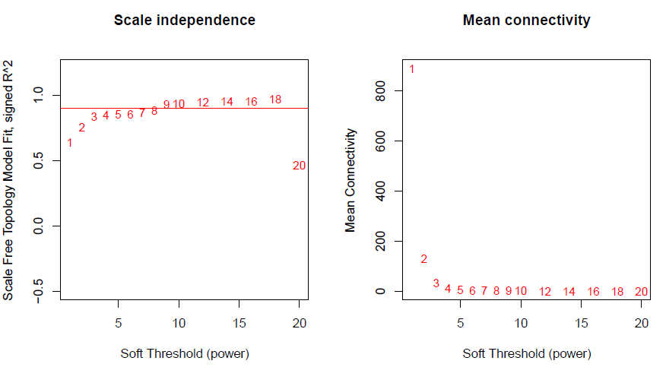
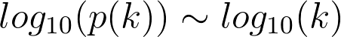
Weighted gene co-expression network (WGCNA)
Characterize gene pairwise co-expression
The gene correlation network is created using the Pearson correlation as a co-expression measure of a given gene across perturbations.
The challenge:
Threshold the Pearson correlation coefficient to arrive at a “relevant” network. Nodes should be connected only if they have a significant pairwise expression profile association.
1
1
2
2
3
3
4
3
Determine the AF parameters
(for soft thresholding)
Criteria: select the threshold that maximize the scale-free topology criterion while maintaining a high mean number of connections.
A scale-free network:
its degree of distribution follows a power law
relative commonness of vertices with a degree greatly higher than average (hubs)
strong connection → robustness to failures
Result: an adjacency matrix A
Practically: R² >.8 for the regression
Zhang, B., & Horvath, S. (2005).
Notes:
Where pk is the fraction of the nodes in the network having k connections
Standard beta values:

Slide 13
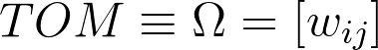
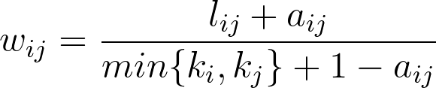
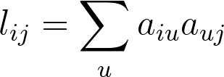
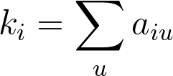
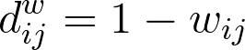
Weighted gene co-expression network (WGCNA)
Characterize gene pairwise co-expression
The gene correlation network is created using the Pearson correlation as a co-expression measure of a given gene across perturbations.
The challenge:
Threshold the Pearson correlation coefficient to arrive at a “relevant” network. Nodes should be connected only if they have a significant pairwise expression profile association.
1
1
2
2
3
3
4
4
4
Define a measure of Node Dissimilarity
Mostly used the Topological Overlap Measure, that reflects nodes relative interconnectedness
The dissimilarity counterpart, TOM-based dissimilarity is used for following steps:
Zhang, B., & Horvath, S. (2005).

Slide 14
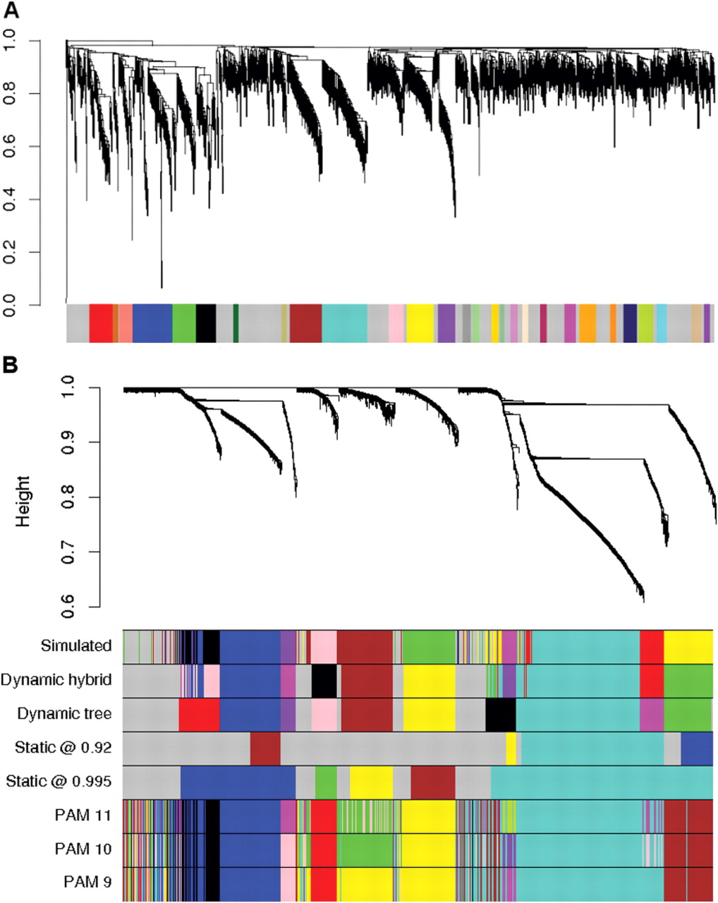
Weighted gene co-expression network (WGCNA)
5
5
Identify Network Modules
5
Network modules = groups of genes whose expression profiles are highly correlated across the samples = groups of nodes with high topological overlap.
Two step:
Average hierarchical clustering coupled with the TOM-based dissimilarity d^{w}_{ij}
Cut the dendogram branches
constant height cutoff value (suboptimal on complex trees)
Dynamic Tree Cut (R package): two-step definition of clusters that improves detection outlying members of each cluster
6
7
Zhang, B., & Horvath, S. (2005), Langfelder, P., Zhang, B. & Horvath, S. (2008).
Notes:
) Average linkage hierarchical clustering using the Topological Overlap Matrix (Yip and Horvath, 2007) and the Dynamic Tree cut applied to the protein–protein interaction network of Drosophila (PPI data from BioGRID, www.thebiogrid.org). Module assignment is depicted by the row of color immediately below the dendrogram, with gray representing unassigned proteins. A functional enrichment analysis has shown that the clusters are significantly enriched with known gene ontologies (Dong and Horvath, 2007). Note that a fixed height cutoff would not be able to identify many of the shown clusters. (B) Hierarchical cluster tree and various cluster detection methods applied to a simulated gene expression data set. The color bands below the dendrogram show the cluster membership according to different clustering methods. The color gray is reserved for genes outside any proper cluster, i.e., the tree cut methods allow for unassigned objects. The first color band ‘Simulated’ shows the simulated true cluster membership; color bands ‘Dynamic Hybrid’ and ‘Dynamic Tree’ show the results of the proposed tree cutting methods; the color band ‘Static @ 0.92’ shows the results of the standard, constant height cut-off method at height 0.92. The height refers to the y axis of the dendrogram. The color band ‘PAM 11’ shows the results of k = 11 medoid clustering.

Slide 15
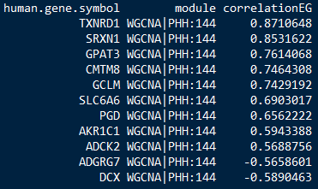
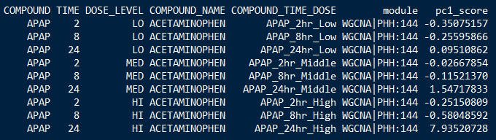
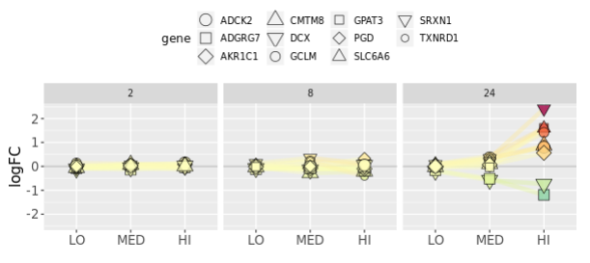
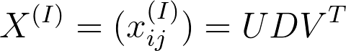
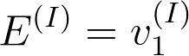
Weighted gene co-expression network (WGCNA)
5
5
Identify Network Modules
5
Network modules = groups of genes whose expression profiles are highly correlated across the samples = groups of nodes with high topological overlap.
Two step:
Average hierarchical clustering coupled with the TOM-based dissimilarity d^{w}_{ij}
Cut the dendogram branches
constant height cutoff value (suboptimal on complex trees)
Dynamic Tree Cut (R package): two-step definition of clusters that improves detection outlying members of each cluster
6
6
7
6
Relate Network concepts to Each Other
Quantify the “importance” of a modules for a certain condition: calculate the module eigengene scores
Obtained by applying the Singular Value Decomposition to the module expression matrix:
Gene expression matrix of module I
i genes in the module
j samples/conditions
1st principal component (in terms of PCA)
Zhang, B., & Horvath, S. (2005), Langfelder, P., Zhang, B. & Horvath, S. (2008).

Slide 16

Weighted gene co-expression network (WGCNA)
5
5
Identify Network Modules
5
Network modules = groups of genes whose expression profiles are highly correlated across the samples = groups of nodes with high topological overlap.
Two step:
Average hierarchical clustering coupled with the TOM-based dissimilarity d^{w}_{ij}
Cut the dendogram branches
constant height cutoff value (suboptimal on complex trees)
Dynamic Tree Cut (R package): two-step definition of clusters that improves detection outlying members of each cluster
6
6
7
7
7
Relate Network concepts to External Gene or Sample Information
Gene level:
Functional enrichment (GO, KEGG..)
Transcription Factor enrichment and/or activity
Protein physical connections (Protein-Protein Interactions)
Sample information:
Pathology measurements and observations
6
Relate Network concepts to Each Other
Quantify the “importance” of a modules for a certain condition: calculate the module eigengene scores
Obtained by applying the Singular Value Decomposition to the module expression matrix:
Gene expression matrix of module I
i genes in the module
j samples/conditions
1st principal component (in terms of PCA)
Zhang, B., & Horvath, S. (2005), Langfelder, P., Zhang, B. & Horvath, S. (2008).

Slide 17
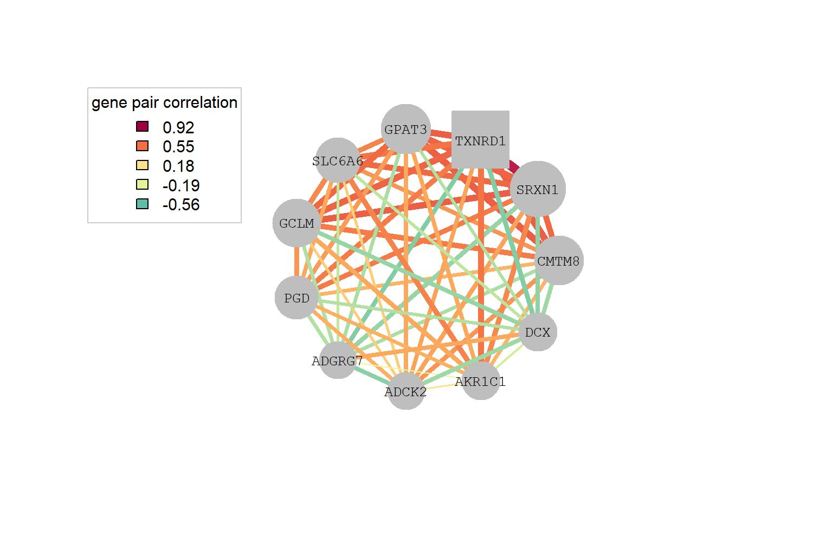
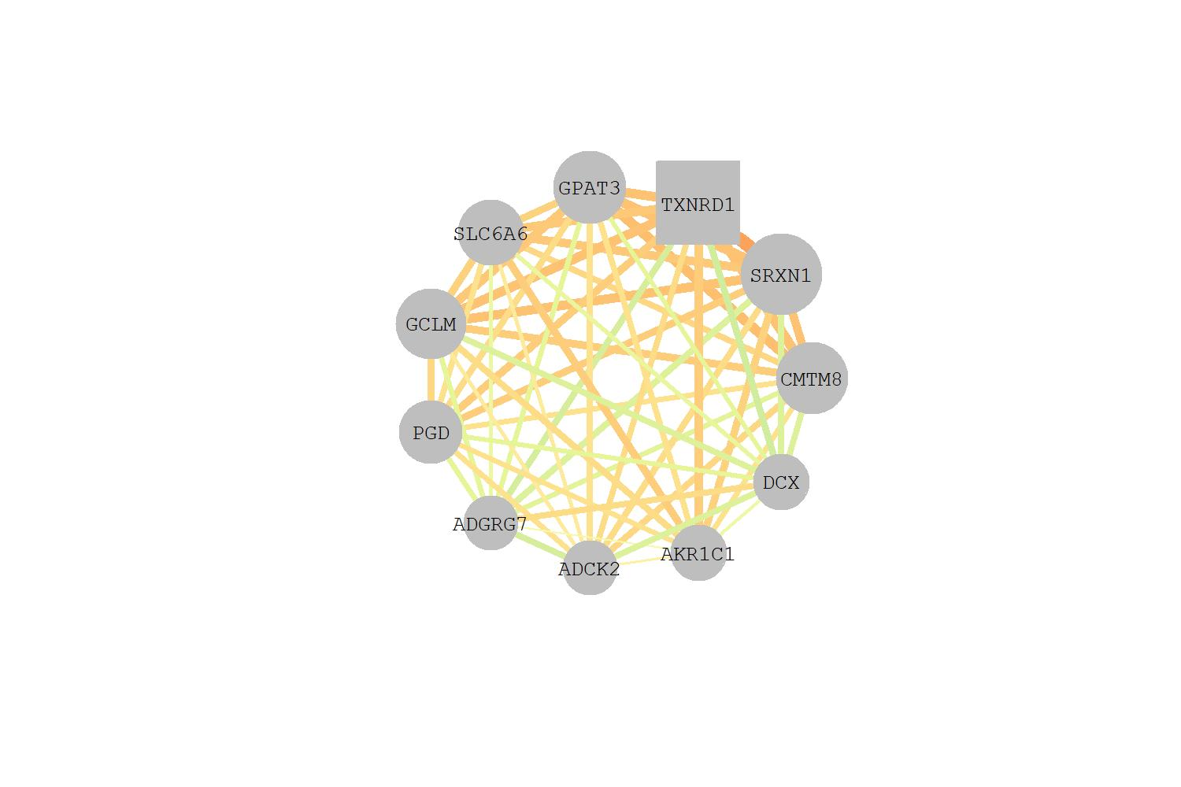
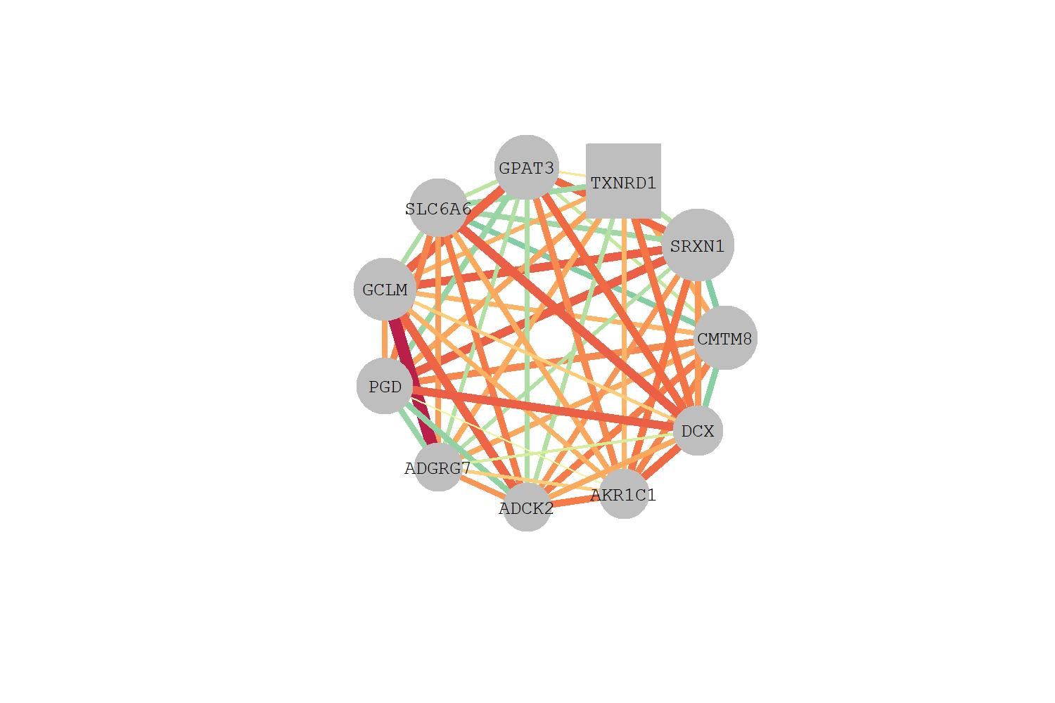
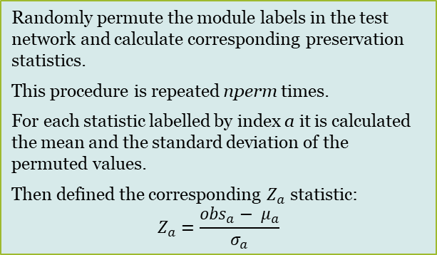
Weighted gene co-expression network (WGCNA)
8
Compare networks
5
5
6
Modules are networks
6
7
7
Cross-tabulation based statistics​ | Network based statistics​
require independent module detection in test and reference sets​ | independent module detection not required​
strict, cannot detect strong non-preservation:​ | For every module in the reference network:​
‘the module cannot be found irrespective of the parameters settings of the module detection procedures’​ | Density based: do modules nodes remain highly connected in the test network?​
​ | Separability based: do network modules remain distinct from another in the test network?​
​ | Connectivity based: is the connectivity pattern between the nodes in the ref network similar to that in test network?​
8
Compare networks
Typical values of module preservation statistics depend on many factors:
network size
module size
number of observations
…
Thus, instead of attempting to define thresholds for considering a preservation statistic significant, use permutation tests.
Can I see the same network topology in an external dataset?
Randomly permute the module labels in the test network and calculate corresponding preservation statistics.
This procedure is repeated nperm times.
For each statistic labelled by index a it is calculated the mean and the standard deviation of the permuted values.
Then defined the corresponding $Z_{a}$ statistic:
$$Z_{a}=\frac{{obs}_{a}− μ_{a}}{σ_{a}}$$
Is the network less dense?
Different relationships between nodes?
Langfelder, P., et al., PLoS Comput Biol 7, 2011.​

Slide 18
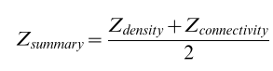
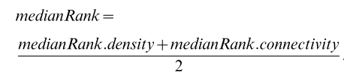
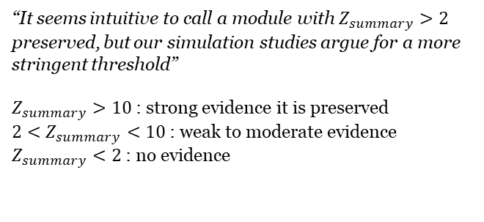
Weighted gene co-expression network (WGCNA)
8
Compare networks
5
5
6
Modules are networks
6
7
7
Cross-tabulation based statistics​ | Network based statistics​
require independent module detection in test and reference sets​ | independent module detection not required​
strict, cannot detect strong non-preservation:​ | For every module in the reference network:​
‘the module cannot be found irrespective of the parameters settings of the module detection procedures’​ | Density based: do modules nodes remain highly connected in the test network?​
​ | Separability based: do network modules remain distinct from another in the test network?​
​ | Connectivity based: is the connectivity pattern between the nodes in the ref network similar to that in test network?​
8
Compare networks
Several network properties: composite statistics.
1) Z-summary
“It seems intuitive to call a module with $Z_{summary}>2$ preserved, but our simulation studies argue for a more stringent threshold”
$Z_{summary}>10$: strong evidence it is preserved
$2<Z_{summary}<10$: weak to moderate evidence
$Z_{summary}<2$: no evidence
Can I see the same network topology in an external dataset?
Strongly dependent on modules size
2) MedianRank: a relative measure of module preservation.
Rely on observed statistics, rather than on permutation.
For each statistic a, modules are ranked based on the observed values. Thus, each module is assigned a rank for each observed statistic. Then the median density and connectivity ranks are defined
Is the network less dense?
Different relationships between nodes?
Langfelder, P., et al., PLoS Comput Biol 7, 2011.​

Slide 19
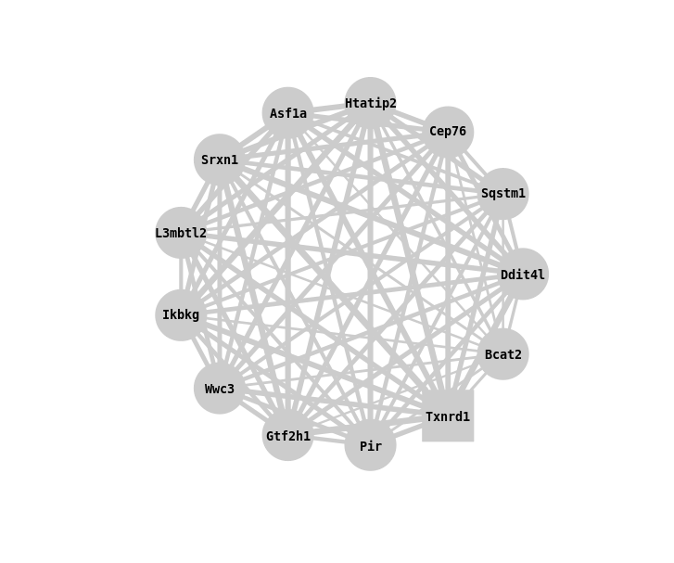
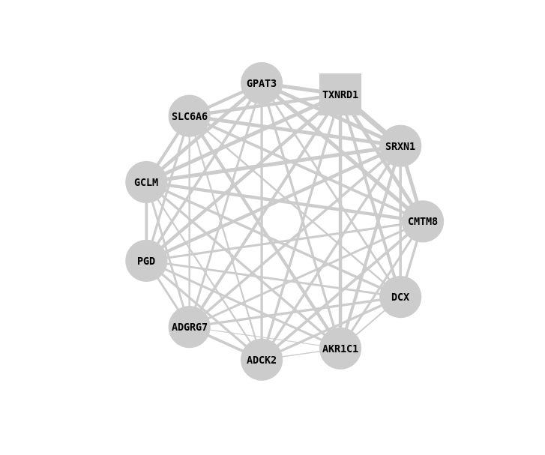
Weighted gene co-expression network (WGCNA)
8
Compare networks
5
5
6
6
7
7
Cross-tabulation based statistics​ | Network based statistics​ independent module detection not required​
require independent module detection in test and reference sets​
strict, cannot detect strong non-preservation:​ | For every module in the reference network:​
‘the module cannot be found irrespective of the parameters settings of the module detection procedures’​ | Density based: do modules nodes remain highly connected in the test network?​
​ | Separability based: do network modules remain distinct from another in the test network?​
​ | Connectivity based: is the connectivity pattern between the nodes in the ref network that in test network?​
8
Compare networks
Leiden liver, module 101
PHH, module 144
How:
Contingency table (# of genes falling in each pair of 2 modules)
Fisher exact test to evaluate significance
Langfelder, P., et al., PLoS Comput Biol 7, 2011.​
Langfelder, P., et al., PLoS Comput Biol 7, 2011.​

Slide 20
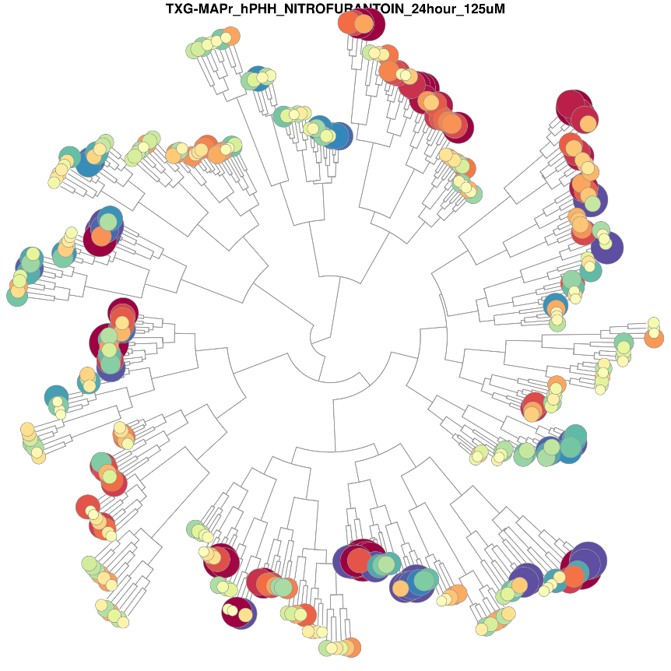
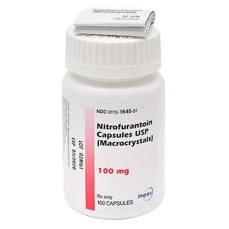

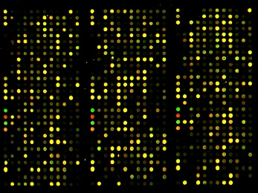
Today’s practice
Nitrofurantoin
Apply WGCNA to a toxicogenomics dataset
Code can be found on GitHub
3 timepoints (2, 8 and 24 hours) & 3 concentrations (5, 25 and 125 uM)
Browse our extended version of WGCNA applied to a larger dataset
Visualize same compound
Extract data: 941 different PHH treatments
TG-GATEs database
Normalization:
Robust Multi Array Average (RMA)
Contrast treatment vs control:
log2fc
Measured on microarray platform
Notes:
Apply WGCNA to a toxicogenomics dataset
Preprocessed log2fc PHH exposed to nitrofurantoin (explain preprocessing steps)
Code can be found on GitHub (link)
Browse our extended version of WGCNA applied to a larger dataset
Link to the website (PHH tool). Guest credentials can be used
Visualize same compound!

Slide 21



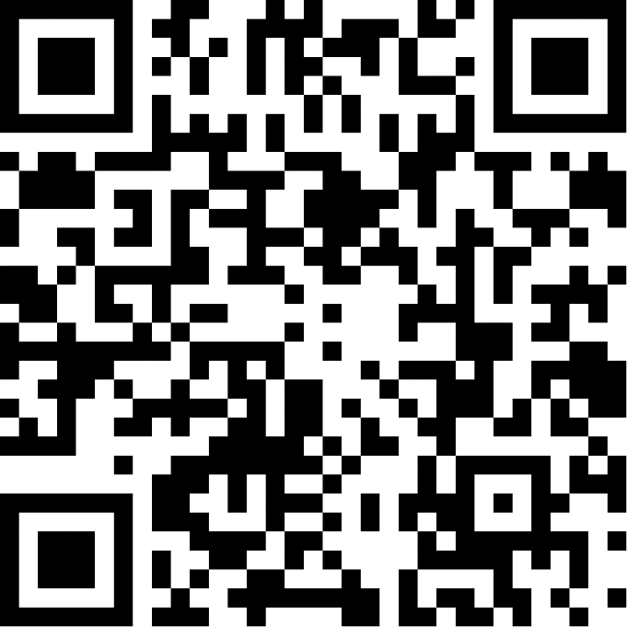
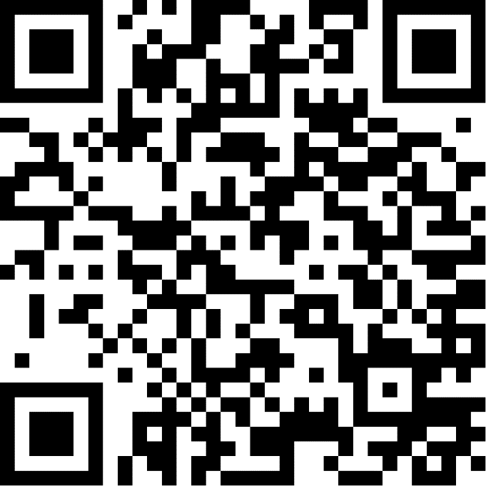
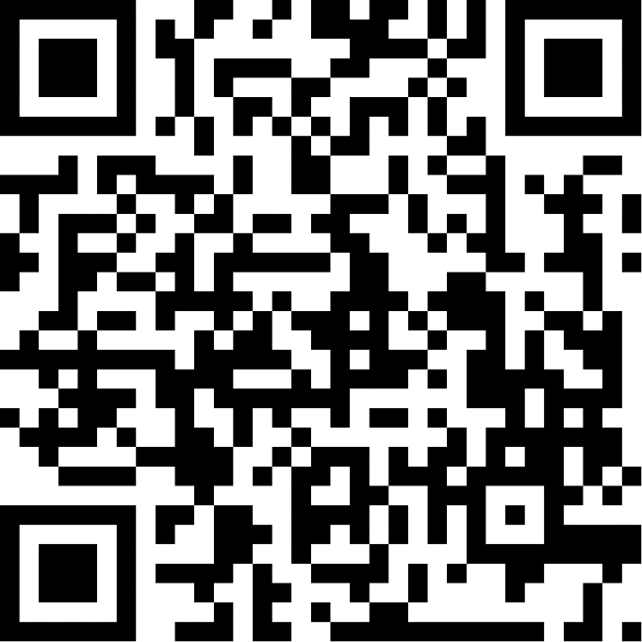
https://tinyurl.com/2kn2djkz
https://tinyurl.com/5bv9udjb
https://txg-mapr.eu/login/
TXG-MAPr
Username: guest
Password: login4guest
Code + input data
Topological Overlap Matrix output

